Slide 1
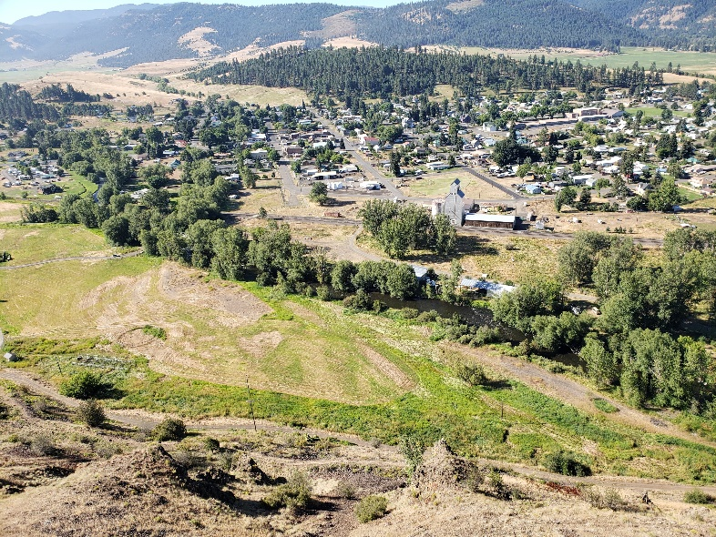
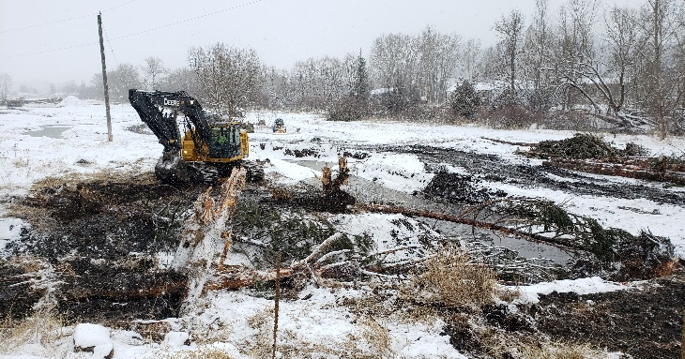
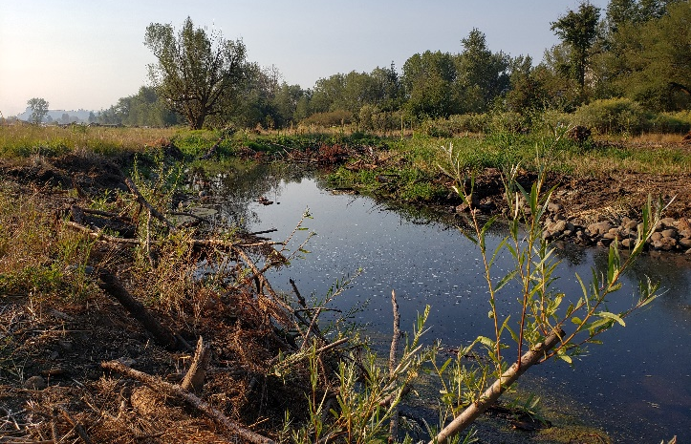
Wallowa River/Tamkaliks Side Channel and Wetland Complex:
Atlas Tier 1, WMS-1 Subwatershed
IMPLEMENTER: Nez Perce Tribe
Location: Wallowa River, near Wallowa, Oregon
Implementation: 2021; Contract #: 74017-51
PROJECT BACKGROUND: Within this middle section of the Wallowa River the river has been channelized and disconnected from its floodplain to accommodate agricultural practices, road and rail road construction, and residential development. The channel lacks habitat complexity and off-channel habitat necessary for all life stages of ESA listed fish that utilize this reach.
ESA ESU or DPS: Snake River spring/summer Chinook salmon ESU, Lostine/Wallowa River spring Chinook salmon population. Snake River summer steelhead ESU, Wallowa River summer steelhead population.
IMPLEMENTATION ACTIONS:
1,789 linear feet of new side channel excavated
15 pools, 2 backwater wetland nodes, and 1 large alcove excavated
LWD installation included 4 inlet/outlet structures, 17 side channel whole tree structures, and 20 alcove whole tree structures
300 CY of in-situ riffle material and additional habitat boulders installed
~400 14-24+ inch diameter boulders placed in mainstem Wallowa River
>1,000 linear feet of side channel brush bank treatments installed
>1.6 acres of furrowed and ridged roughened floodplain interspersed with 600 linear feet of willow trenches
~0.6 acres of wetland grading and 12,200 10 CI wetland plugs planted
HABITAT RESPONSE: Since implementation, the following habitat features have significantly improved within the project reach: floodplain connectivity; floodplain and wetland vegetation; large wood densities; increased pool and zero velocity habitat.
FISH RESPONSE: This project has improved migration, holding, spawning, and summer and winter rearing habitat for salmon, steelhead, and Pacific lamprey, ultimately resulting in positive impacts to population abundance, productivity and viability.
Pre-Construction Overview
Looking SW (August 2020)
Left: Summer Construction (July)
Above: Winter Construction (February)

Slide 2
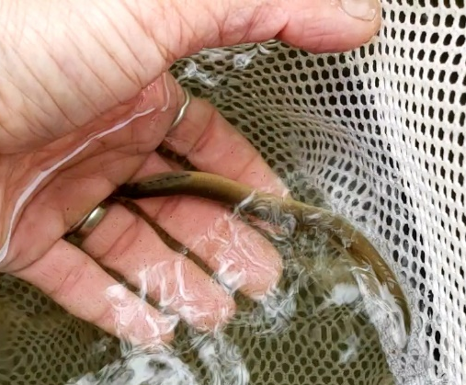
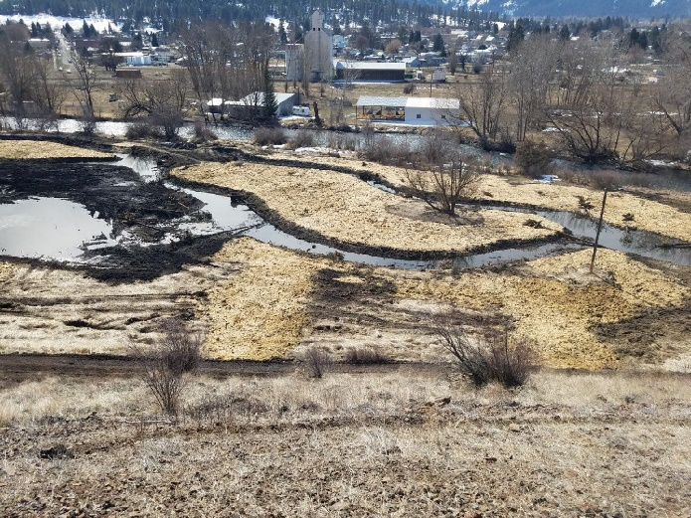
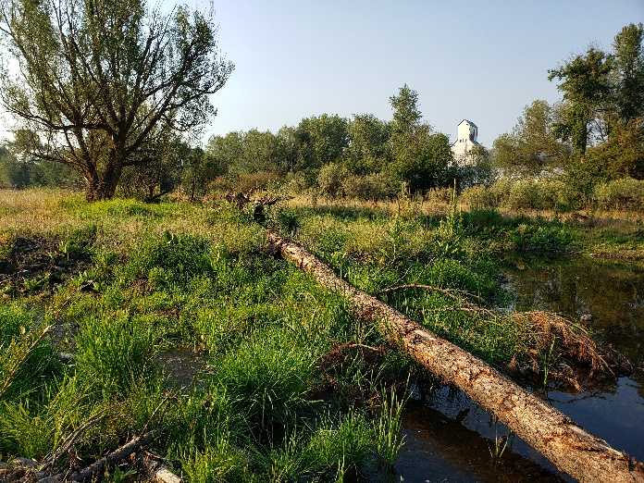
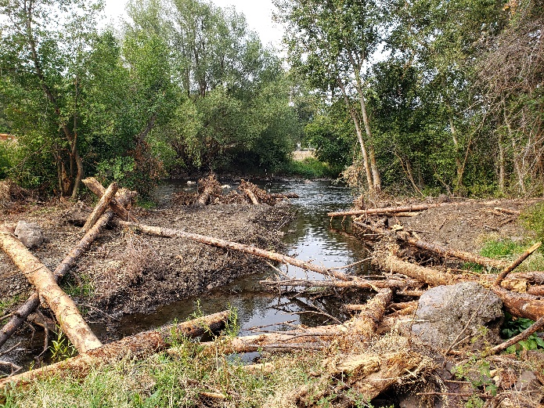
Pacific Lamprey Ammocoete Sampled During Mainstem Wallowa River Fish Salvage (August)
Pre-Implementation
(Courtesy of GRMW, June 2019)
Post-Implementation
(Courtesy of GRMW, June 2021)
Mid-Project Reach Post Winter Construction (April)
Mid-Project Reach Post Summer Construction (August)
Alcove at Outlet (August)

